Slide 1




















O list E-commerce Analysis
By group-2

Slide 2
Massive Dataset: We analyzed over 112.59K total orders and behaviors of 94.5K distinct customers.
Objective: To uncover purchasing trends, pinpoint logistical efficiencies, and map payment behaviors.
Multi-Tool Approach: Data was meticulously processed and visualized using industry-standard tools: Excel, Tableau, SQL, and Power BI.
PROJECT SUMMARY

Slide 3
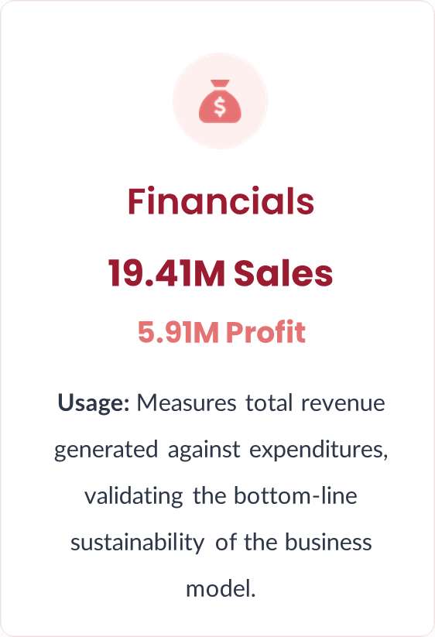
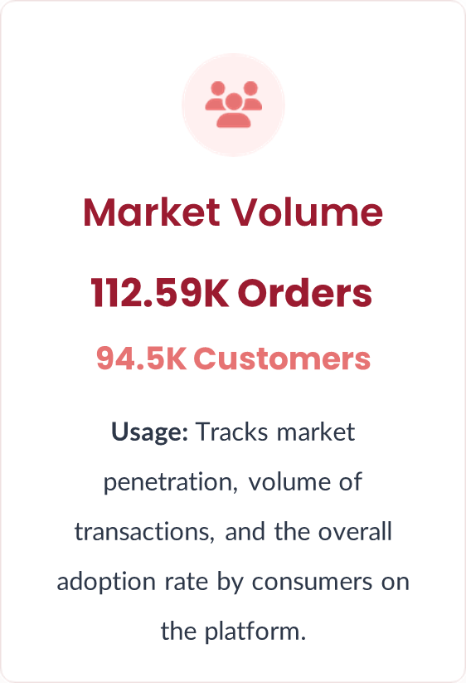
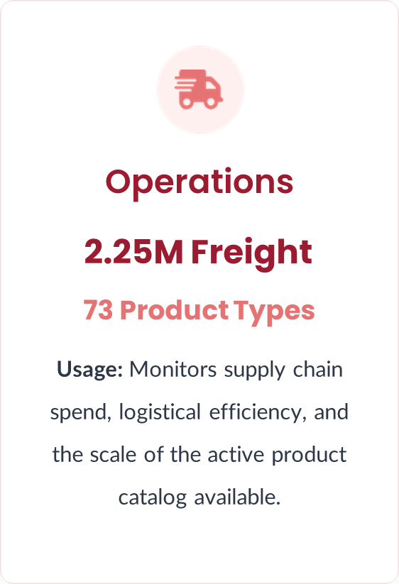
KEY PERFORMANCE INDICATORS
(KPI’s)

Slide 4
EXCEL DASHBOAD
TABLEAU DASHBOARD
POWERBI DASHBOARD
SQL QUERIES
Overall, this dashboard explains the complete analysis of the Olist E-commerce dataset and gives us insights about customer behavior, sales performance, delivery efficiency, and customer satisfaction.
Key Insights from Dashboard
Weekday vs Weekend Sales Analysis
Payment & Customer Satisfaction
Pet Shop Delivery Performance
São Paulo Customer Spending Behaviour
Shipping Time vs Review Score
Dash Boards of ecommerce analysis
DashBoards of Ecommerce Analysis

Slide 5
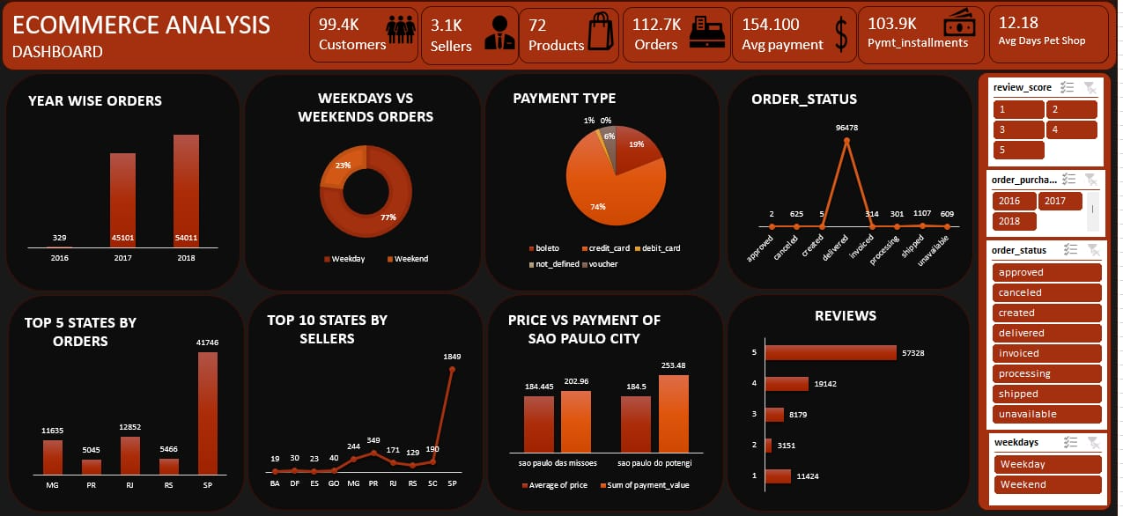
TABLEAU DASHBOARD
POWERBI DASHBOARD
SQL QUERIES
DashBoards of Ecommerce Analysis

Slide 6
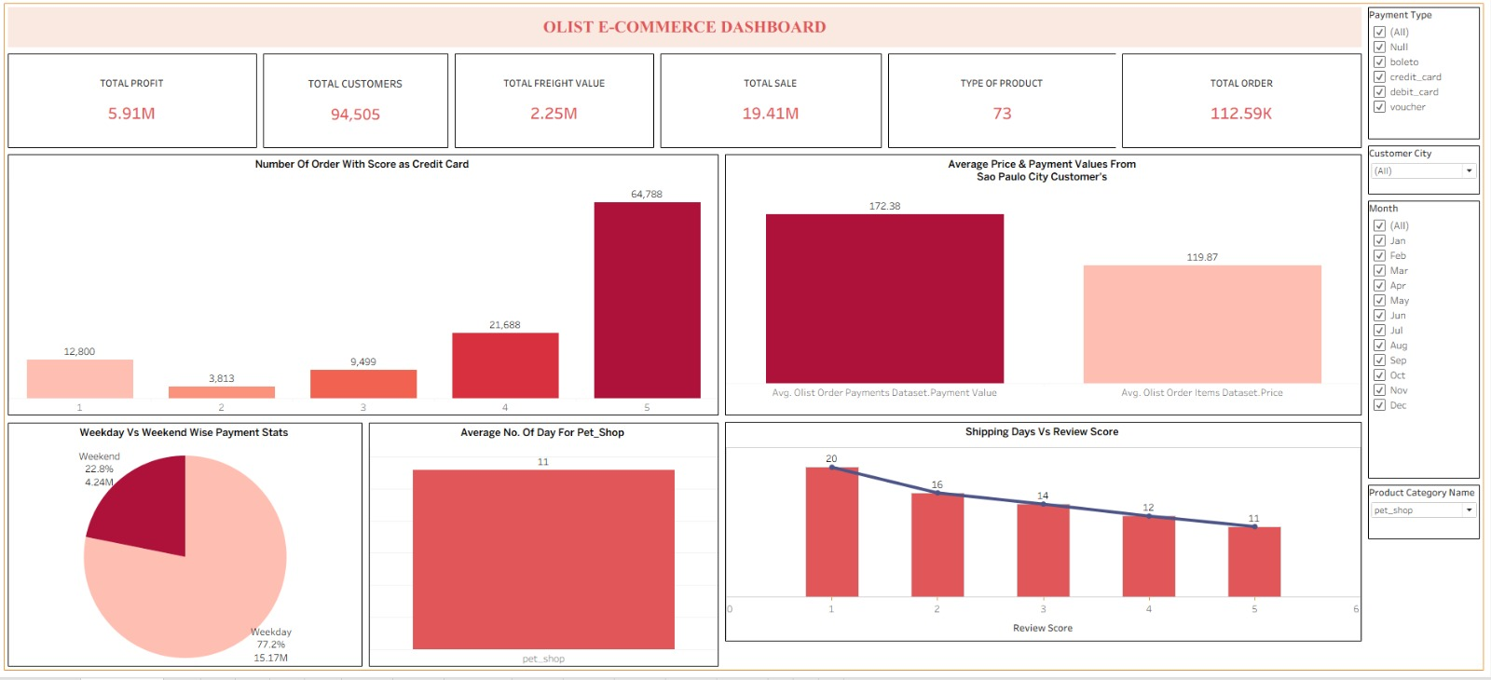
EXCEL DASHBOADR
POWERBI DASHBOARD
SQL QUERIES
DashBoards of Ecommerce Analysis

Slide 7
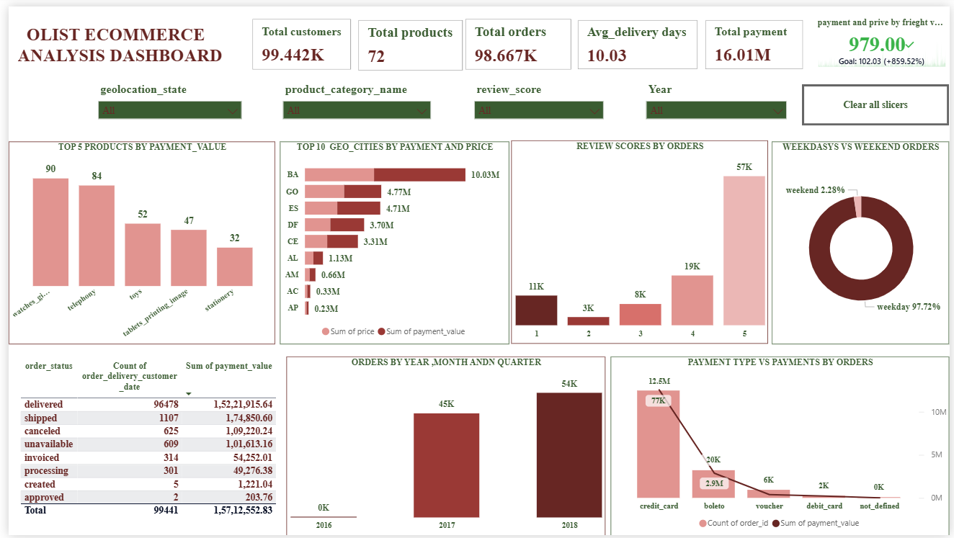
EXCEL DASHBOADR
TABLEAU DASHBOARD
POWERBI DASHBOARD
SQL QUERIES
DashBoards of Ecommerce Analysis

Slide 8
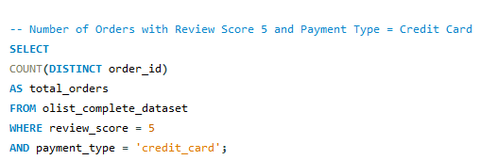

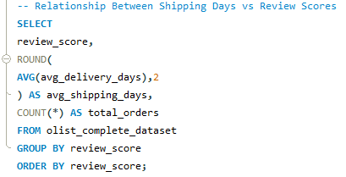

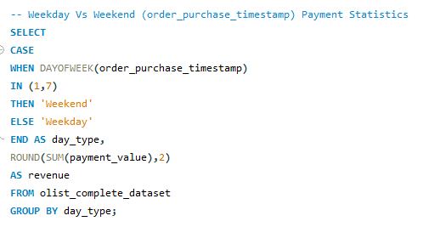
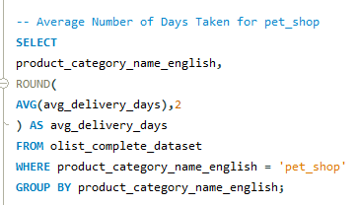
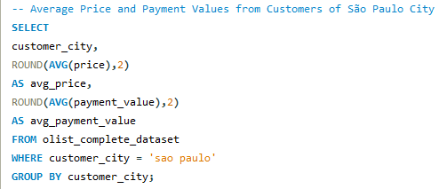
EXCEL DASHBOADR
TABLEAU DASHBOARD
POWERBI DASHBOARD
SQL QUERIES
DashBoards of Ecommerce Analysis

Slide 9
Key Takeaways
1. Logistics Drives Loyalty: Fast shipping directly correlates with 5-star reviews. Reducing shipping times below the 11-day average is critical. 2. Strategic Marketing: With 77.2% of payments occurring on weekdays, promotional spend should be heavily targeted Monday through Friday. 3. Dashboard Impact: Utilizing Excel, Tableau, and Power BI transformed raw tables into a roadmap, proving that data visibility is the first step toward scalable profitability.

Slide 10
THANK YOU
Presented By :
Karan Shubham Abhinay
Hemasree Sneha Mounika Janhavi

